Slide 1
Applied Cryptography MAC definition, security
Liangfeng Zhang
School of Information Science and Technology
ShanghaiTech University

Slide 2
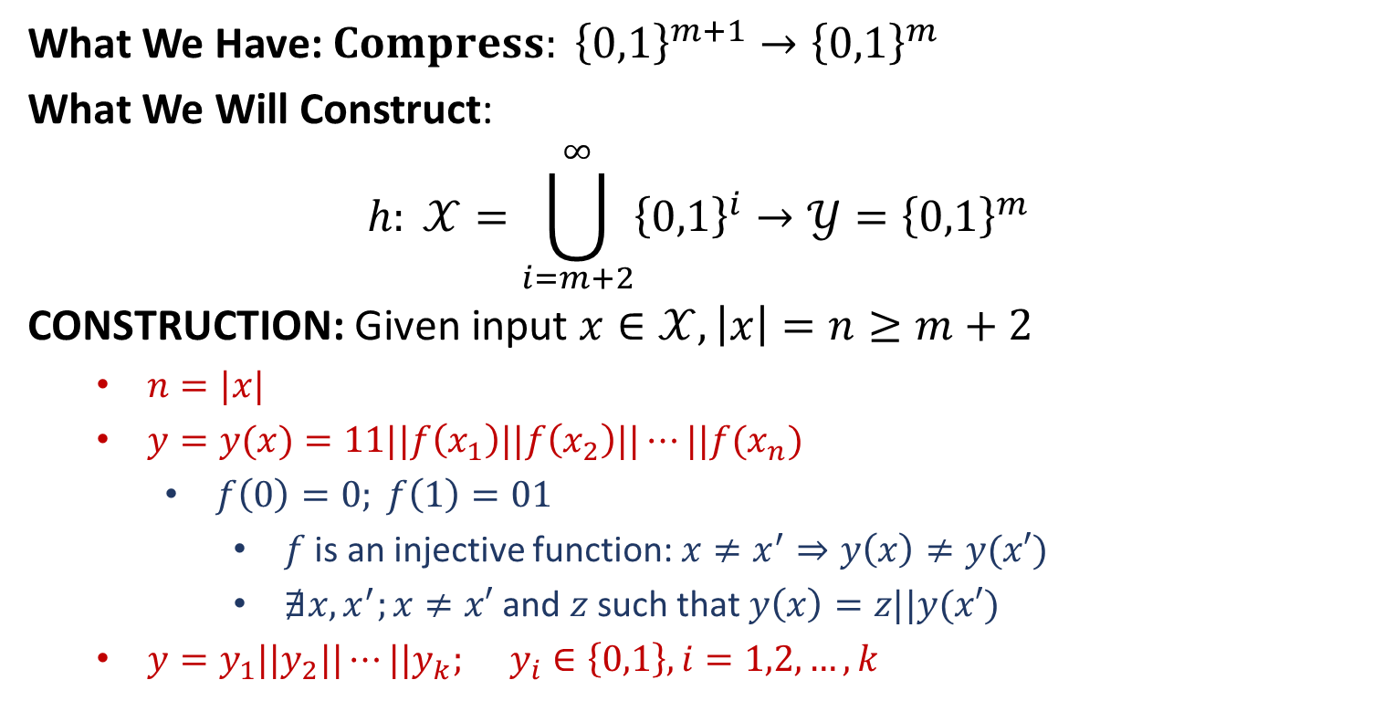
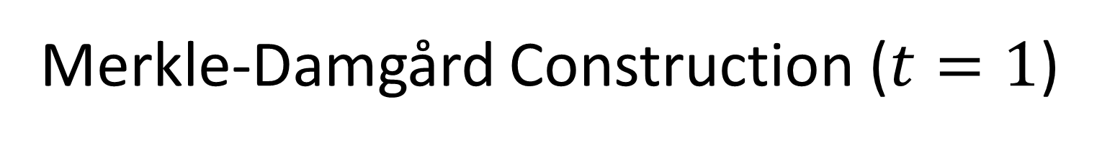
Merkle-Damgård Construction ($t=1$)
What We Have: $Compress: {\left\{0,1\right\}}^{m+1}→{\left\{0,1\right\}}^{m}$
What We Will Construct:
$$h: 𝒳=\bigcup_{i=m+2}^{∞}{{\left\{0,1\right\}}^{i}}→𝒴={\left\{0,1\right\}}^{m}$$
CONSTRUCTION: Given input $x∈𝒳, \left|x\right|=n≥m+2$
$n=|x|$
$y=y(x)=11||f\left(x_{1}\right)||f\left(x_{2}\right)||⋯||f(x_{n})$
$f\left(0\right)=0; f\left(1\right)=01$
$f$ is an injective function: $x≠x^{′}⇒y\left(x\right)≠y(x′)$
$∄x,x^{′};x≠x′$ and $z$ such that $y\left(x\right)=z||y(x′)$
$y=y_{1}||y_{2}||⋯||y_{k}; y_{i}∈\left\{0,1\right\}, i=1,2,…,k$

Slide 3









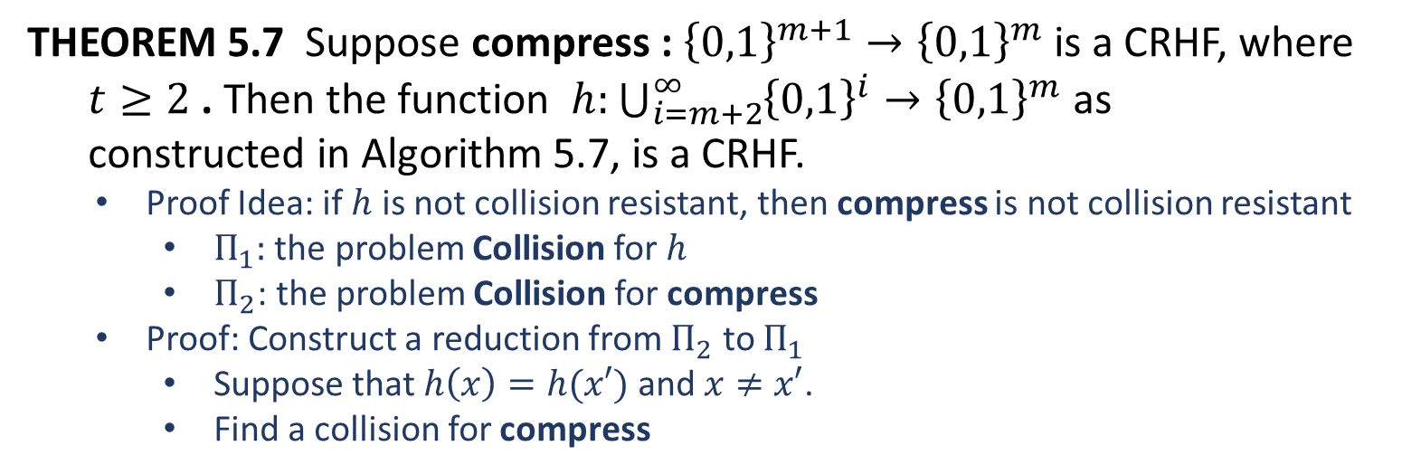




The Processing Step
$y_{1}$
$$y_{2}$$
$$y_{3}$$
$$⋯$$
$$y_{k}$$
$$IV$$
compress
compress
compress
compress
compress
$$h(x)$$
$$0^{m }$$
$$g_{1}$$
$$g_{2}$$
$$⋯$$
$$g_{k−1}$$
$$g_{k}$$
THEOREM 5.7 Suppose compress : ${\left\{0,1\right\}}^{m+1}→{\left\{0,1\right\}}^{m}$ is a CRHF, where
$t≥2$ . Then the function $h:\bigcup_{i=m+2}^{∞}{{\left\{0,1\right\}}^{i}→{\left\{0,1\right\}}^{m}}$ as
constructed in Algorithm 5.7, is a CRHF.
Proof Idea: if $h$ is not collision resistant, then compress is not collision resistant
$Π_{1}:$ the problem Collision for $h$
$Π_{2}$: the problem Collision for compress
Proof: Construct a reduction from $Π_{2}$ to $Π_{1}$
Suppose that $h\left(x\right)=h(x′)$ and $x≠x′$.
Find a collision for compress

Slide 4










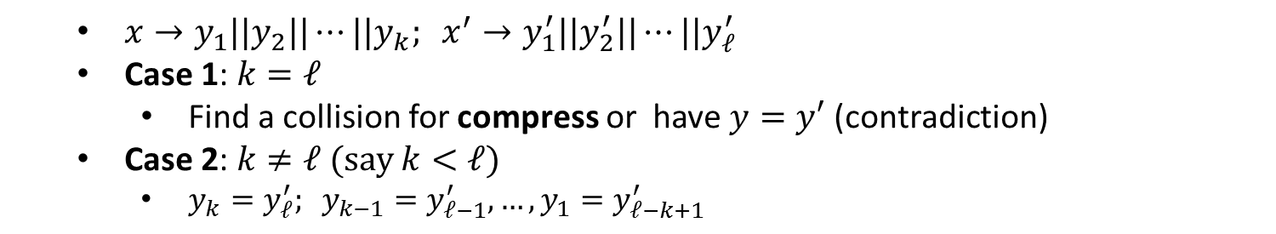
















$y_{1}$
$$y_{2}$$
$$y_{3}$$
$$⋯$$
$$y_{k}$$
$$IV$$
compress
compress
compress
compress
compress
$$h(x)$$
$$0^{m }$$
$$g_{1}$$
$$g_{2}$$
$$⋯$$
$$g_{k−1}$$
$$g_{k}$$
$y_{1}^{′}$
$$y_{2}^{′}$$
$$y_{3}^{′}$$
$$⋯$$
$$y_{ℓ}^{′}$$
$$IV$$
compress
compress
compress
compress
compress
$$h(x′)$$
$$0^{m }$$
$$g_{1}^{′}$$
$$g_{2}^{′}$$
$$⋯$$
$$g_{ℓ−1}^{′}$$
$$g_{ℓ}^{′}$$
$x→y_{1}||y_{2}||⋯||y_{k}; x^{′}→y_{1}^{′}||y_{2}^{′}||⋯||y_{ℓ}^{′}$
Case 1: $k=ℓ$
Find a collision for compress or have $y=y′$ (contradiction)
Case 2: $k≠ℓ$ (say $k<ℓ$)
$y_{k}=y_{ℓ}^{′}; y_{k−1}=y_{ℓ−1}^{′},…,y_{1}=y_{ℓ−k+1}^{′}$

Slide 6
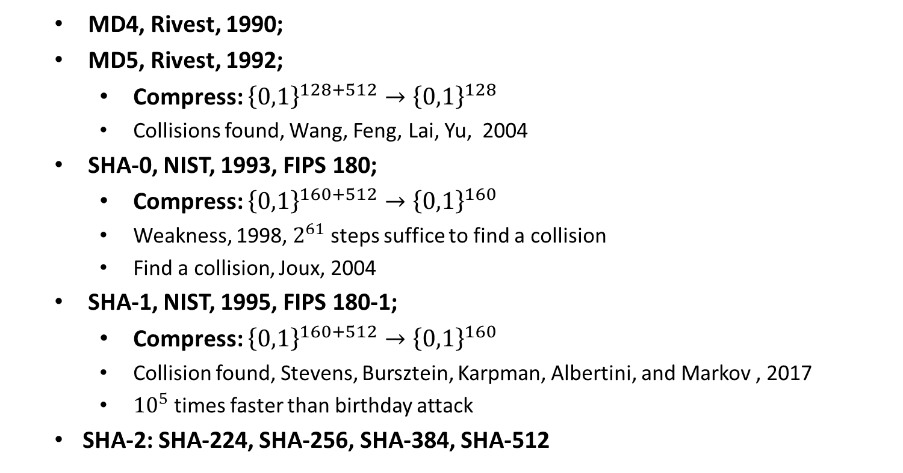

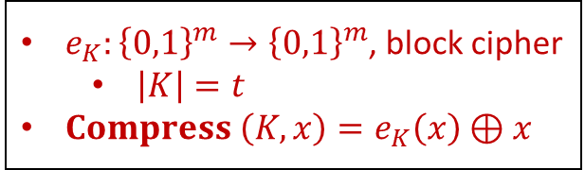

$Compress$ for MD
MD4, Rivest, 1990;
MD5, Rivest, 1992;
Compress: ${\left\{0,1\right\}}^{128+512}→{\left\{0,1\right\}}^{128}$
Collisions found, Wang, Feng, Lai, Yu, 2004
SHA-0, NIST, 1993, FIPS 180;
Compress: ${\left\{0,1\right\}}^{160+512}→{\left\{0,1\right\}}^{160}$
Weakness, 1998, $2^{61}$ steps suffice to find a collision
Find a collision, Joux, 2004
SHA-1, NIST, 1995, FIPS 180-1;
Compress: ${\left\{0,1\right\}}^{160+512}→{\left\{0,1\right\}}^{160}$
Collision found, Stevens, Bursztein, Karpman, Albertini, and Markov , 2017
${10}^{5}$ times faster than birthday attack
SHA-2: SHA-224, SHA-256, SHA-384, SHA-512
$e_{K}:{\left\{0,1\right\}}^{m}→{\left\{0,1\right\}}^{m}$, block cipher
$\left|K\right|=t$
$Compress \left(K,x\right)=e_{K}\left(x\right)⊕x$
Davies-Meyer Construction
of $Compress$

Slide 7









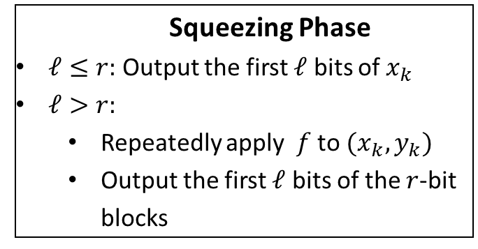















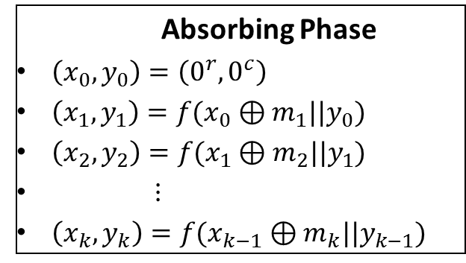


The Sponge Construction
$$M$$
$$Z$$
pad
$$Trunc_{ℓ}$$
$$m_{1}$$
$$m_{2}$$
$$m_{3}$$
$$m_{4}$$
$$x_{0}$$
$$⊕$$
$$x_{1}$$
$$⊕$$
$$x_{2}$$
$$⊕$$
$$x_{3}$$
$$x_{4}$$
$$r$$
$$0$$
$$⊕$$
$$f$$
$$f$$
$$f$$
$$f$$
$$f$$
$$f$$
…
$$c$$
$$0$$
$$y_{0}$$
$$y_{1}$$
$$y_{2}$$
$$y_{3}$$
$$y_{4}$$
absorbing squeezing
Sponge (Example: $k=4$)
Absorbing Phase
$\left(x_{0}, y_{0}\right)=\left(0^{r},0^{c}\right)$
$\left(x_{1},y_{1}\right)=f(x_{0}⊕m_{1}||y_{0})$
$\left(x_{2},y_{2}\right)=f(x_{1}⊕m_{2}||y_{1})$
$⋮$
$\left(x_{k},y_{k}\right)=f(x_{k−1}⊕m_{k}||y_{k−1})$
Squeezing Phase
$ℓ≤r:$ Output the first $ℓ$ bits of $x_{k}$
$ℓ>r:$
Repeatedly apply $f$ to $(x_{k},y_{k})$
Output the first $ℓ$ bits of the $r$-bit blocks
SHA-3: SHA3-224, SHA3-256, SHA3-384, SHA3-512

Slide 9
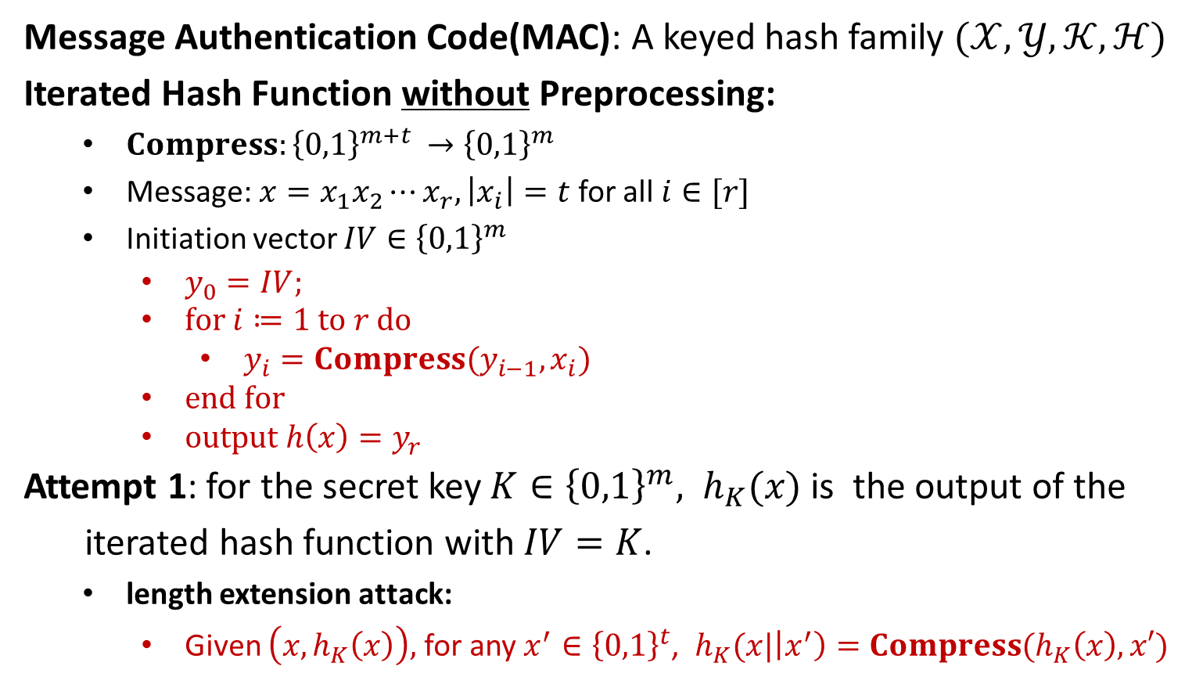
Attempts to Construct MAC
Message Authentication Code(MAC): A keyed hash family $(𝒳,𝒴,𝒦,ℋ)$
Iterated Hash Function without Preprocessing:
$Compress:{\left\{0,1\right\}}^{m+t }→{\left\{0,1\right\}}^{m}$
Message: $x=x_{1}x_{2}⋯x_{r}, \left|x_{i}\right|=t$ for all $i∈[r]$
Initiation vector $IV∈{\left\{0,1\right\}}^{m}$
$y_{0}=IV;$
$for i≔1 to r do$
$y_{i}=Compress(y_{i−1},x_{i})$
$end for$
$output h\left(x\right)=y_{r}$
Attempt 1: for the secret key $K∈{\left\{0,1\right\}}^{m}, h_{K}(x)$ is the output of the
iterated hash function with $IV=K$.
length extension attack:
Given $\left(x,h_{K}\left(x\right)\right),$for any $x^{′}∈{\left\{0,1\right\}}^{t}$, $h_{K}(x|\left|x^{′}\right)=Compress(h_{K}\left(x\right),x′)$

Slide 10

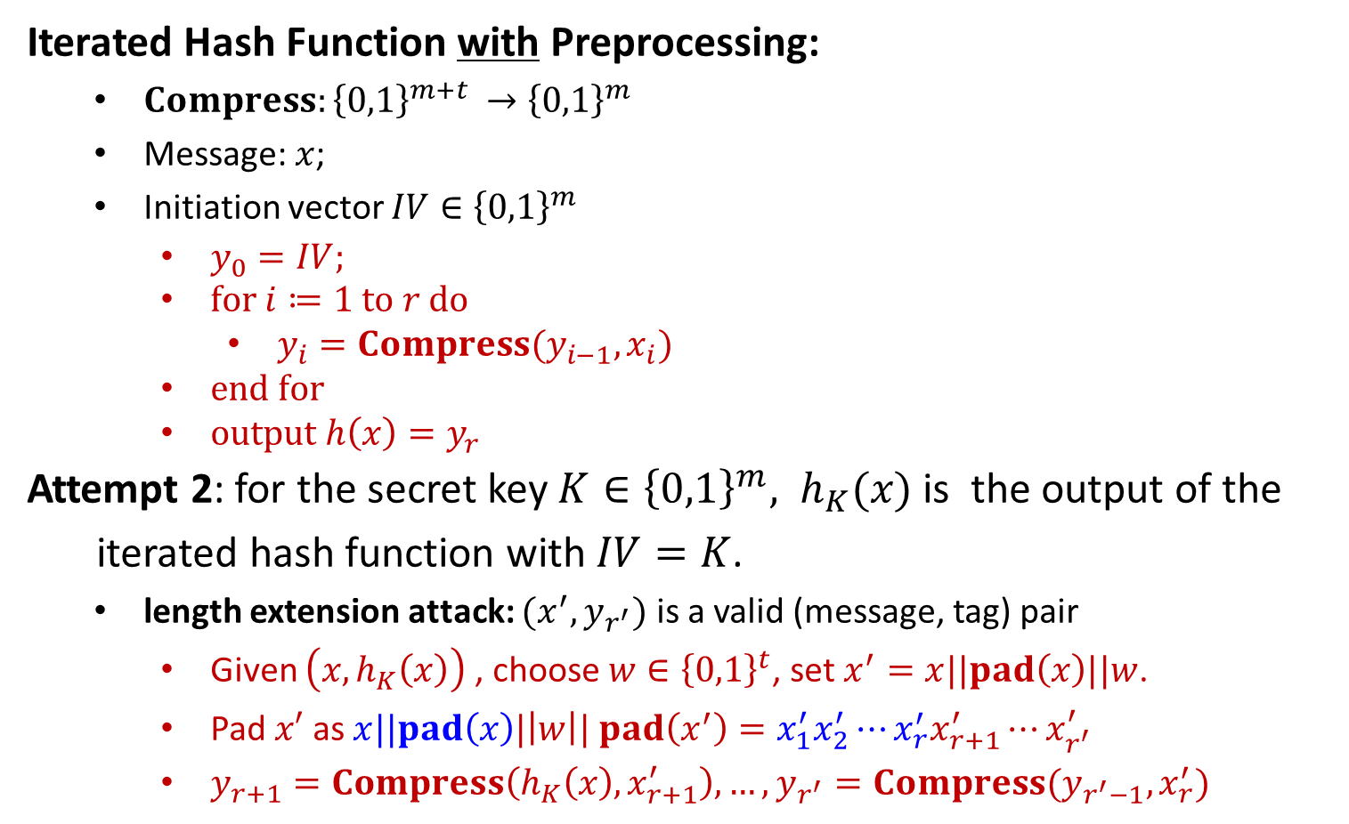
Attempts to Construct MAC
Iterated Hash Function with Preprocessing:
$Compress:{\left\{0,1\right\}}^{m+t }→{\left\{0,1\right\}}^{m}$
Message: $x$;
Initiation vector $IV∈{\left\{0,1\right\}}^{m}$
$y_{0}=IV;$
$for i≔1 to r do$
$y_{i}=Compress(y_{i−1},x_{i})$
$end for$
$output h\left(x\right)=y_{r}$
Attempt 2: for the secret key $K∈{\left\{0,1\right\}}^{m}, h_{K}(x)$ is the output of the
iterated hash function with $IV=K$.
length extension attack: $(x^{′},y_{r^{′}})$ is a valid (message, tag) pair
Given $\left(x,h_{K}\left(x\right)\right)$, choose $w∈{\left\{0,1\right\}}^{t}$, set $x^{′}=x||pad\left(x\right)||w$.
Pad $x′$ as $x||pad\left(x\right)|\left|w\right|| pad\left(x^{′}\right)=x_{1}^{′}x_{2}^{′}⋯x_{r}^{′}x_{r+1}^{′}⋯x_{r^{′}}^{′}$
$y_{r+1}=Compress\left(h_{K}\left(x\right),x_{r+1}^{′}\right), …, y_{r^{′}}=Compress(y_{r^{′}−1}, x_{r}^{′})$
Padded message: $x||pad\left(x\right)=x_{1}x_{2}⋯x_{r}$

Slide 12
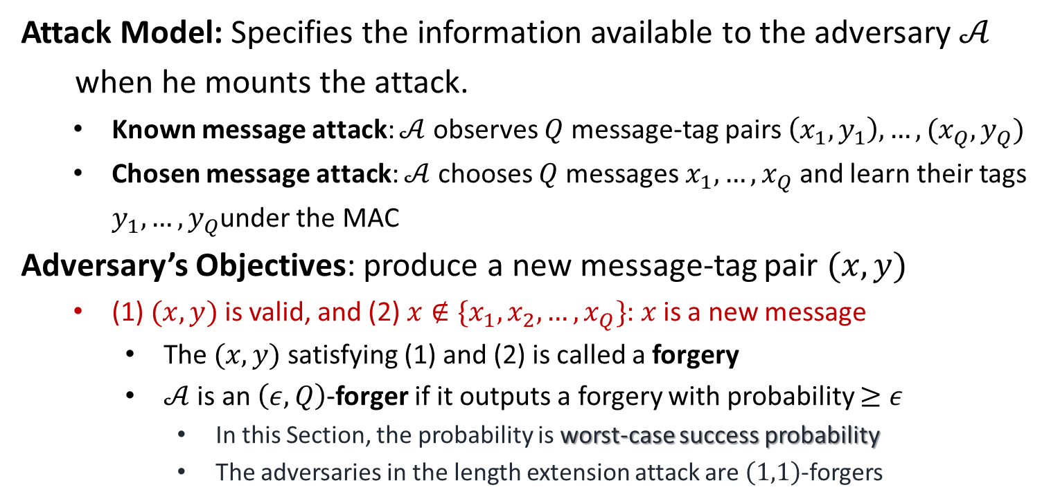
Security of MAC
Attack Model: Specifies the information available to the adversary $𝒜$
when he mounts the attack.
Known message attack: $𝒜$ observes $Q$ message-tag pairs $\left(x_{1},y_{1}\right),…,(x_{Q}, y_{Q})$
Chosen message attack: $𝒜$ chooses $Q$ messages $x_{1}, …,x_{Q}$ and learn their tags $y_{1}, …,y_{Q}$under the MAC
Adversary’s Objectives: produce a new message-tag pair $(x,y)$
(1) $(x,y)$ is valid, and (2) $x∉\{x_{1},x_{2},…,x_{Q}\}$: $x$ is a new message
The $(x,y)$ satisfying (1) and (2) is called a forgery
$𝒜$ is an $\left(ε,Q\right)$-forger if it outputs a forgery with probability $≥ε$
In this Section, the probability is worst-case success probability
The adversaries in the length extension attack are $\left(1,1\right)$-forgers

